Slide 1
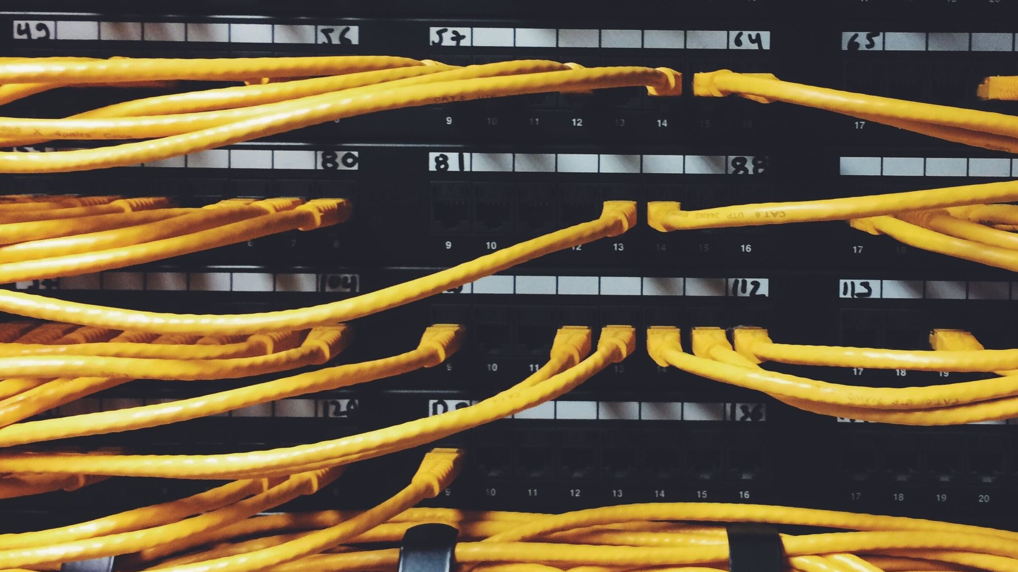
Data Communications

Slide 2

CONCEPT OF COMMUNICATION
Data Communication refers to the exchange of data between two or more networked or connected devices.
These devices should be capable of sending and receiving data over a communication medium.
Example given:
Personal computers
Mobile phones
Laptops etc.

Slide 3
COMPONENTS OF DATA COMMUNICATION
Sender:
A sender is any such device which is capable of sending data over a network.
It can be a computer, mobile phone, smartwatch etc.
Receiver:
A receiver is any such device which is capable of receiving data from the network.
It can be any computer, laptop, television etc.
In computer communication sender and receiver are known as nodes in a network.

Slide 4
Message:
It is the data or information that needs to be exchanged between the sender and the receiver.
Messages can be in the form of text, number, image, audio, video, etc.
Communication media:
It is the path through which the message travels between source and destination.
It is also called medium or link which is either wired or wireless.

Slide 5
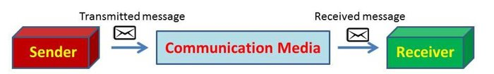

Slide 6

Questions
1.What do you mean by communication?[S1]
2.Who is a sender?[S3]
3.Who is a reciever?[S3]
4.What are nodes?[S4]
5.Path through which the message travels is called________________ .[S4]

Slide 7
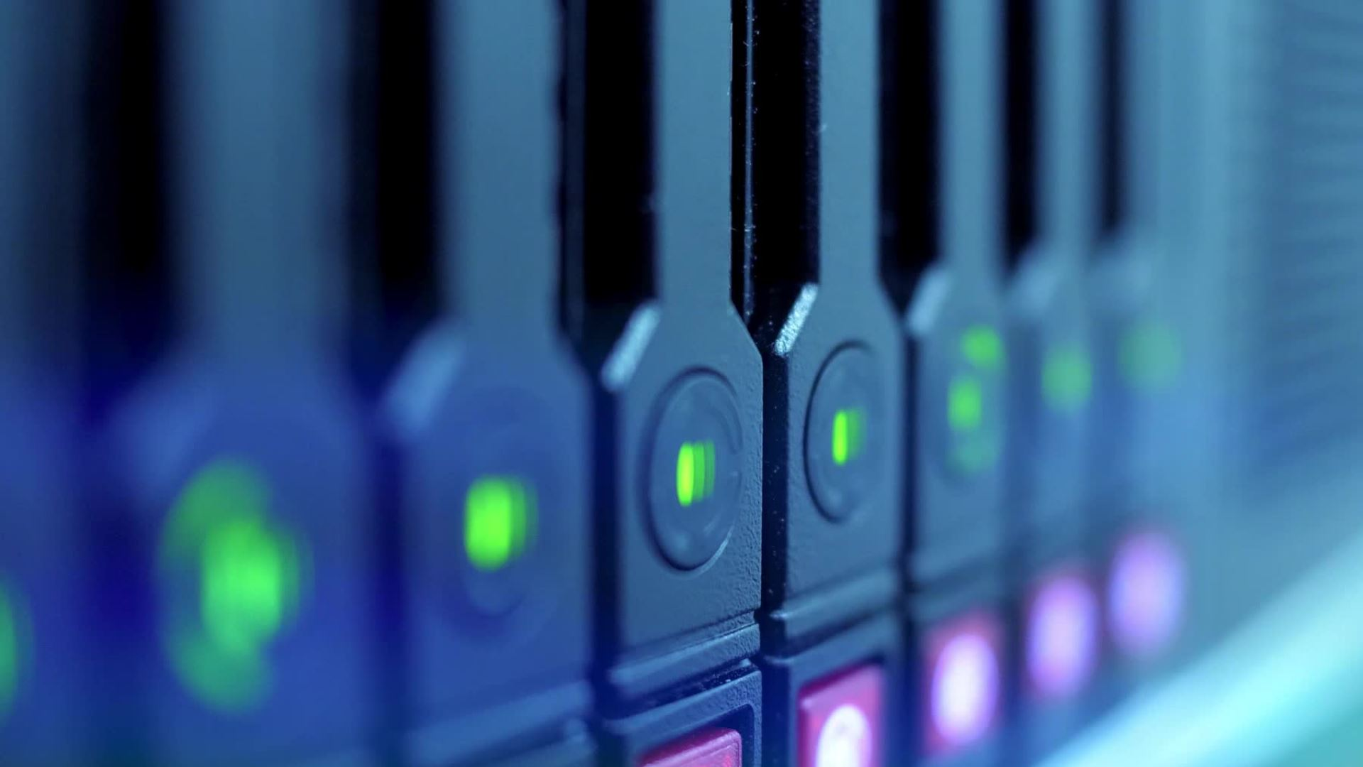
BAUD
It is the unit of measurement for the information carrying capacity of a communication channel. The baud is synonymous with bps (bits per second), another unit of measuring data transfer rates.
NOTE:
Data Channel is the medium used to carry information or data from one point to another

Slide 8
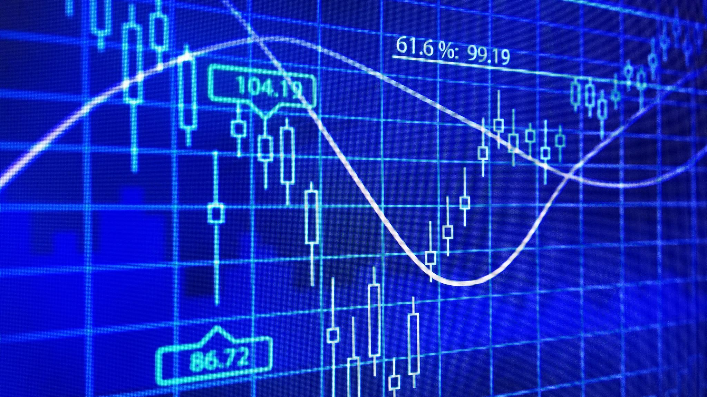
Bits Per Second (bps)
It refers to the speed at which data transfer is measured. It is generally used to measure the speed of information through a high speed phone lines or modems.
Bytes per second are denoted as Bps-notice the capital B.
Small b i.e., bps stands for bits per second.

Slide 9
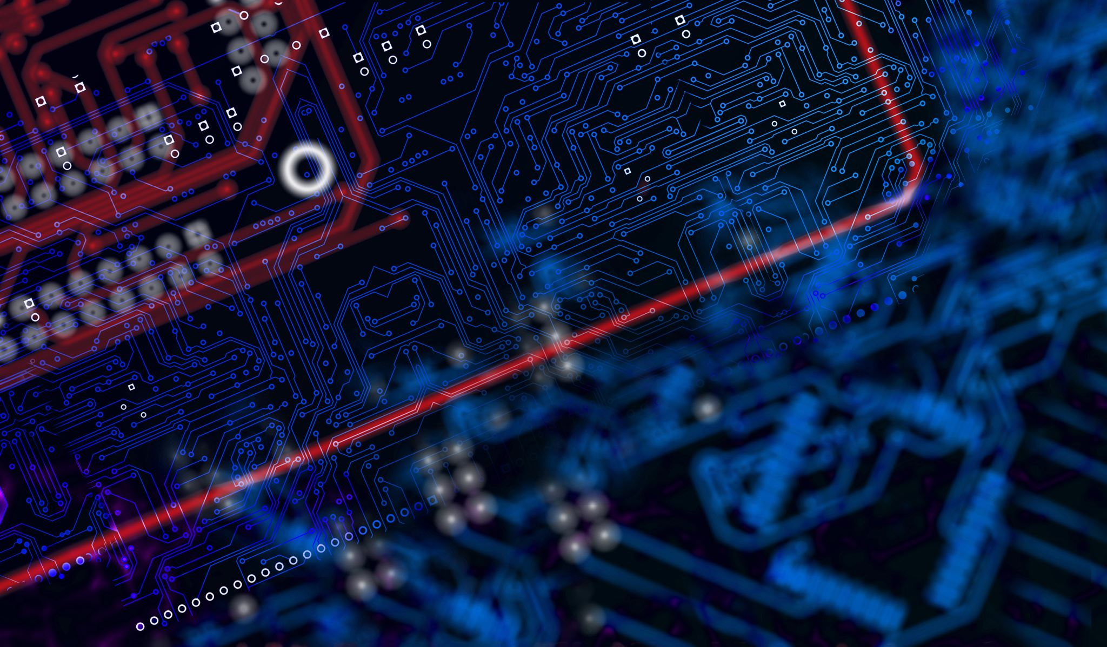
BANDWIDTH
Technically, the bandwidth refers to the difference between the highest and lowest frequency of a transmission channel. Or in other words, the bandwidth refers to the width of allocated band of frequencies to a channel.
Generally speaking, bandwidth is directly proportional to the amount of data transmitted-received per unit time.
For example, it takes more bandwidth to download a photograph in one second than it takes to download a page of text in one second. Large sound files, computer programs, and animated videos require still more bandwidth for acceptable system performance.

Slide 10
In digital systems, bandwidth is data speed in bits per second (bps). Thus, a modem that works a 57,600 bps has twice the bandwidth of a modem that works at 28,800 bps.
In analog systems, bandwidth is defined in terms of the difference between the highest frequency signal component and the lowest-frequency signal component. Frequency is measured in cycles per second i.e., hertz.
A typical voice signal has a bandwidth of a three kilohertz (3 kHz); an analog television (TV) broadcast video signal has a bandwidth of six megahertz (6 MHz) - approximately 2,000 times as wide as the voice signal.

Slide 11
Data Transfer Rates
The data transfer rate represents the amount of data transferred per second by a communications channel or a computing or storage device. Data rate is measured in units of bits per second (bps), bytes per second (Bps), or baud.
Multiplier Prefixes
Date rates- "kilo-", "mega-", "giga-", "tera-" etc.
Eg. 6 kbps is 64 kilo bits per second (64000 bps)
Storage- increase successively with 1024 times.
Eg. 1 MB = 1024 kilobytes; 1 GB = 1024 megabytes

Slide 12

Questions
What is BAUD?
Full form of bps?What is its significance
What is the difference between bps and Bps?
What is bandwidth?
What is the bandwidth of tv broadcast?
What is data transfer rate is measured in?
Convert 6 kbps into bps.
1MB = ____ kb / 1 GB = ____ MB

Slide 13
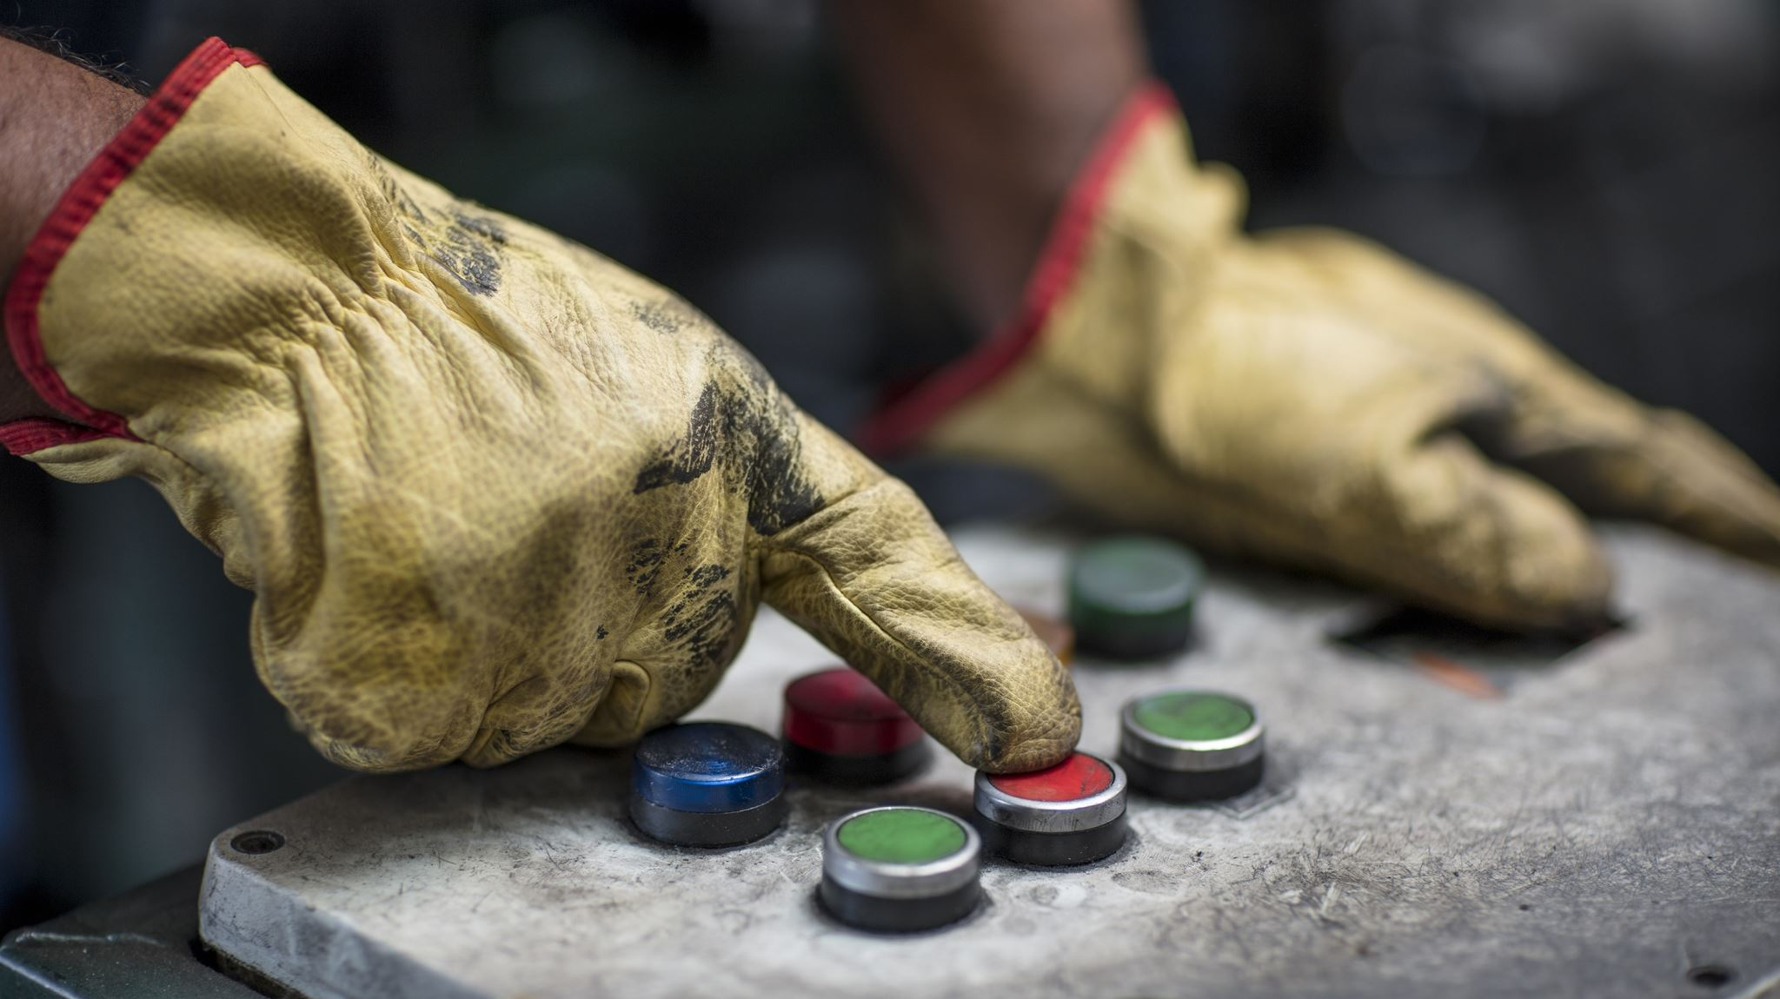
Switching Techniques

Slide 14
What is meant by Switching Techniques?
These are a type of techniques used to connect the sender and receiver so that one-to-one communication is possible.
In this technique , data is routed through various nodes in a network, and forms a temporary route for the data to be transmitted.
Two commonly used switching techniques are — Circuit Switching and Packet Switching.

Slide 15
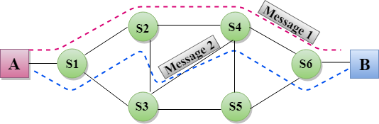
A Visual Representation of Switching Techniques

Slide 16
Any Alternatives? Why just these techniques
Yes, there are many alternatives which include:
To make a dedicated connection between each pair of devices (mesh topology)
To make a dedicated connection between a central device and every other device (star topology)
#However, such methods are costly in case of large networks, thus the most effective method are switching techniques.

Slide 17
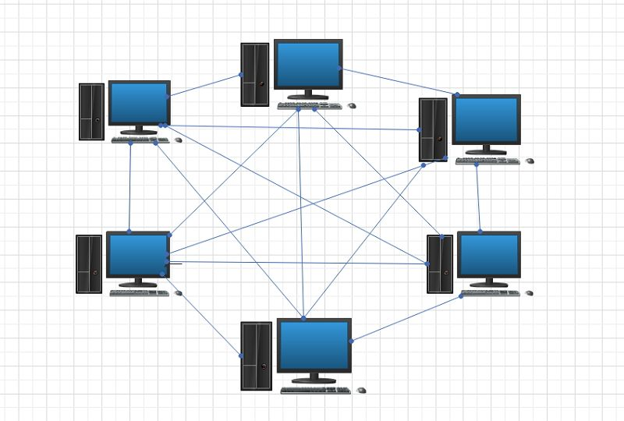
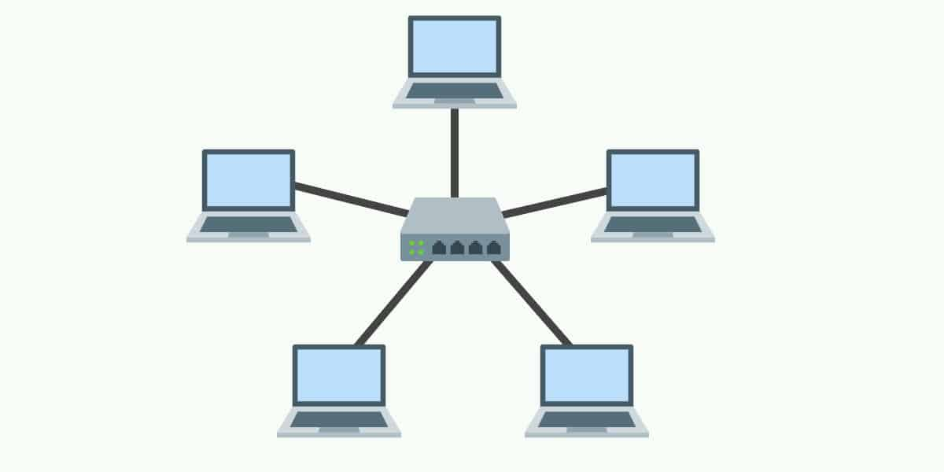
Mesh Topology
Star Topology

Slide 18
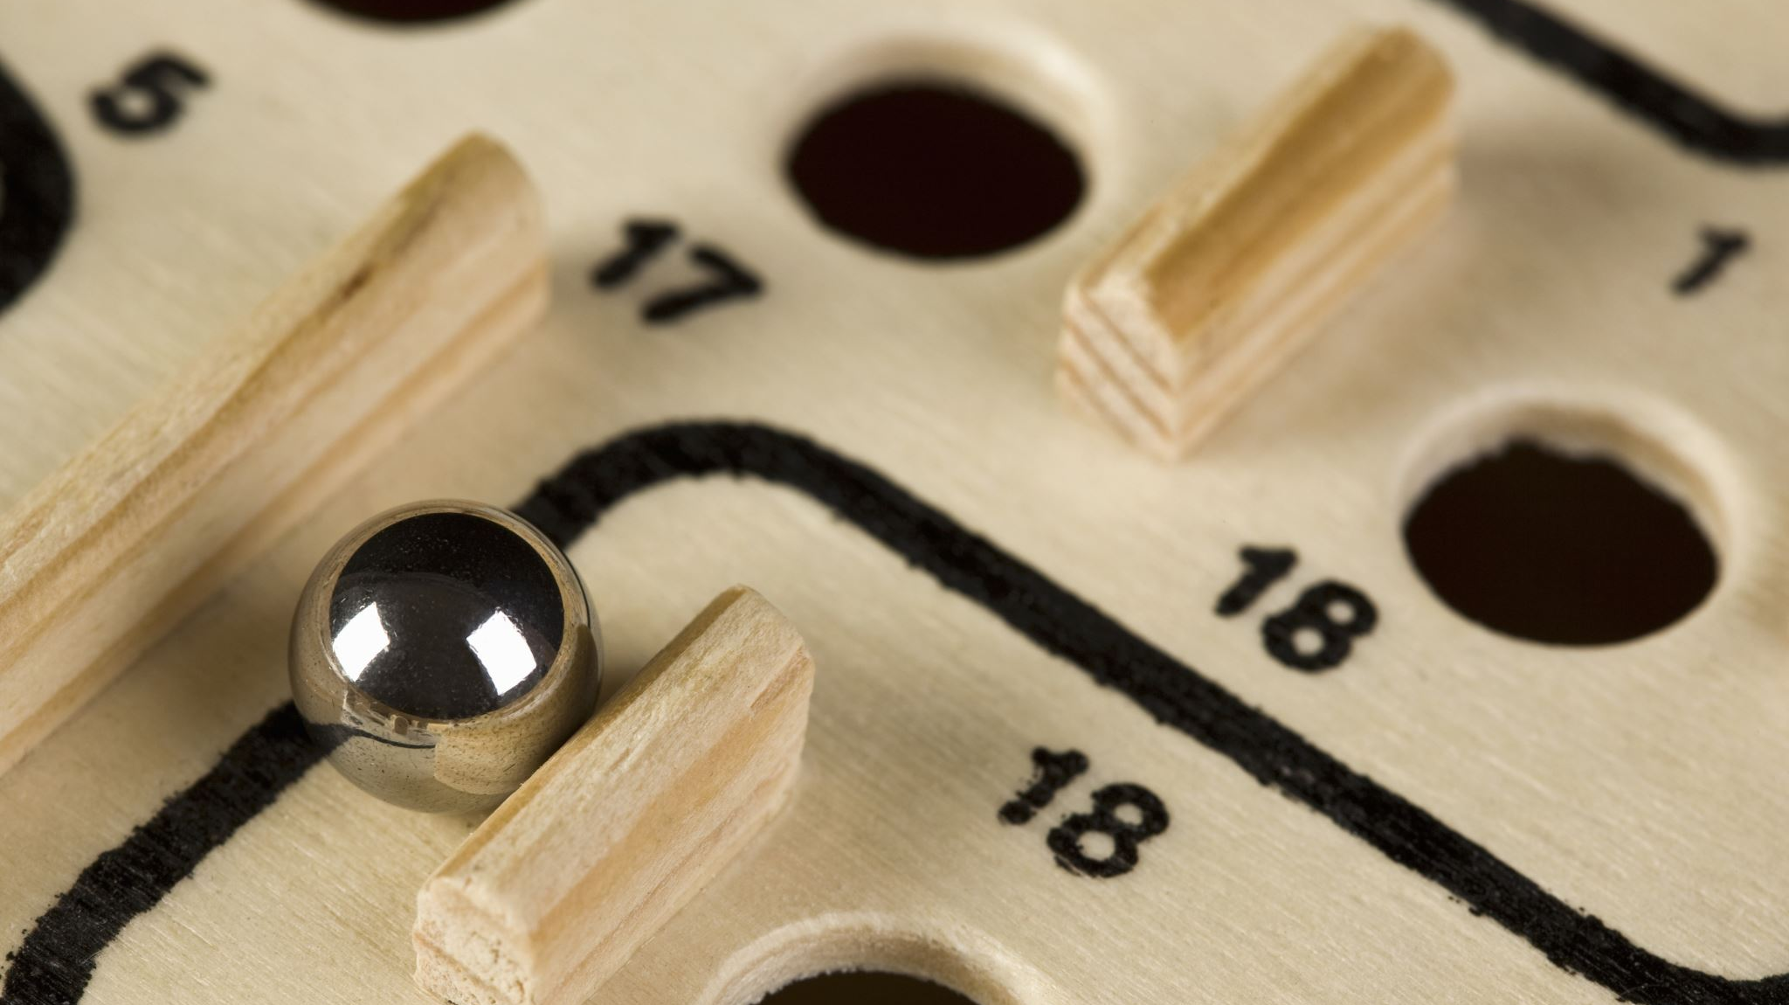
Types of Switching Techniques

Slide 19
1. Circuit Switching
1. In circuit switching, before a communication starts, a dedicated path is identified between the sender and the receiver.
2. This path is a connected sequence of links between network nodes.
3. All packets follow the same path established during the connection. (packets are chunks of information)
Eg : In earlier days, when we placed a telephone call, the switching equipment within the telephone system finds out a physical channel all the way from our telephone at home to the receiver’s telephone.

Slide 20
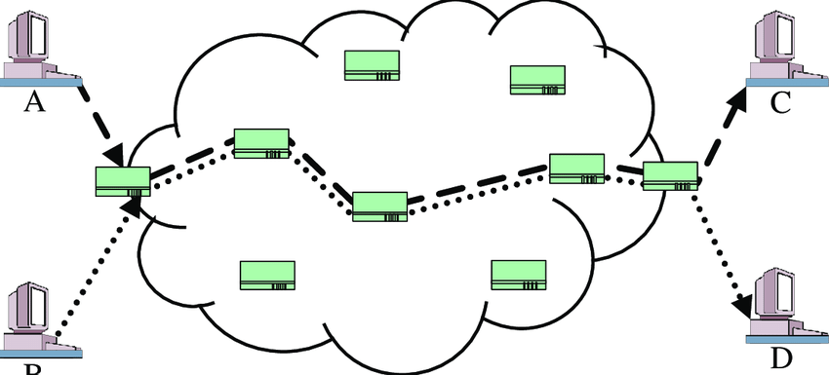
Circuit Switching

Slide 21
2. Packet Switching
1. In packet switching, each information or message to be transmitted between sender and receiver is broken down into smaller pieces, called packets.
2. These packets are then transmitted independently through the network.
3. Different packets of the same message may take different routes depending on availability.

Slide 22

Important points on Packet Switching
Each packet has two parts — a header containing the address of the destination and other information, and the main message part.
When all the packets reach the destination, they are reassembled and the complete message is received by the receiver.
Unlike circuit switching, a channel is occupied in packet switching only during the transmission of the packet. On completion of the transmission, the channel is available for transfer of packets from other communicating parties.

Slide 23
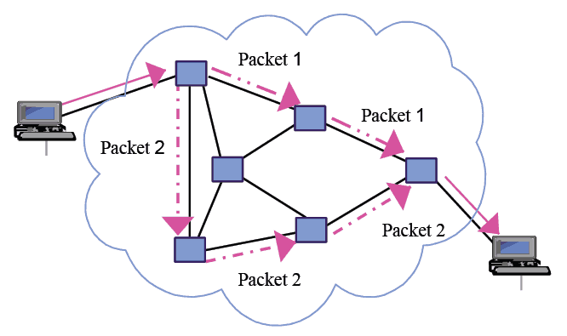
Packet Switching

Slide 24

Questions
What are the two commonly used switching techniques?
Difference between mesh topology and star topology
Types of switching techniques
What is circuit switching
What is packet switching?
what is a header in packet switching?
Difference between circuit switching and packet switching?

Slide 25
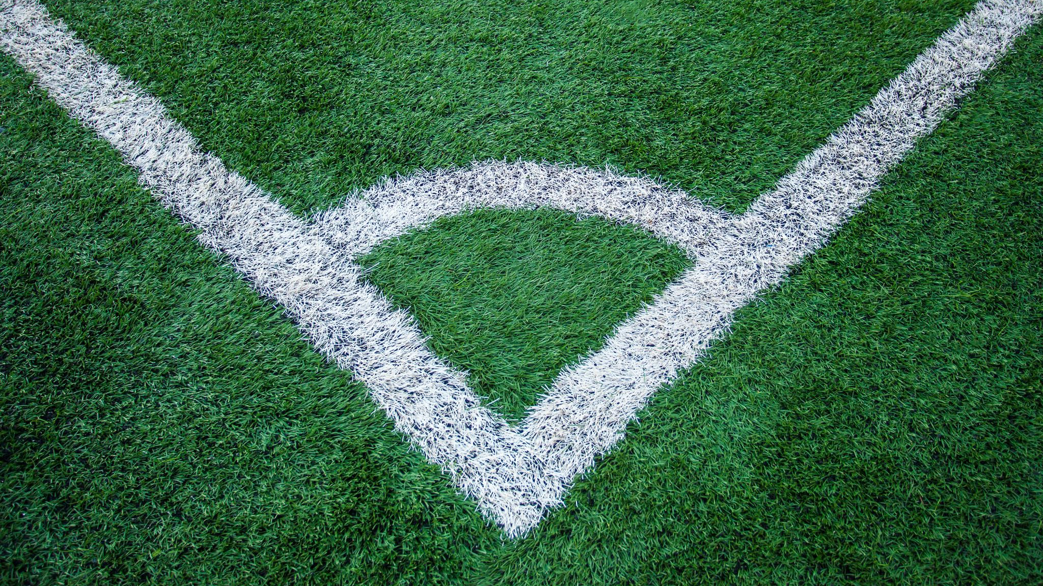
Protocol

Slide 26
Protocol
In communication, Protocol is a set of standard rules that the communicating parties — the sender, the receiver, and all other intermediate devices need to follow.
We need protocols for different reasons such as flow control, access control, addressing, etc.
Flow control is required when the sender and receiver have different speeds of sending and receiving the data.

Slide 27
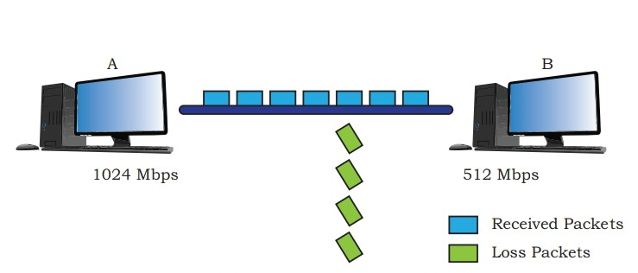
Computer A is sending data at the speed of 1024 Mbps and computer B is receiving data at the speed of 512 Mbps.
In this case, Computer B must be able to inform computer A about the speed mismatch so that computer A can adjust its data transmission rate. Otherwise some data will be lost

Slide 28
Protocols also define
how computers identify one another on a network. the form to which the data should be converted for transit.
how to decide whether the data received is for that node or to be forwarded to another node.
ensuring that all the data have reached the destination without any loss.
how to rearrange the packets and process them at the destination.

Slide 29
Some important protocols are:
Hypertext transfer protocol (HTTP)
File Transfer Protocol (FTP)
Point to Point Protocol (PPP)
Simple Mail Transfer Protocol (SMPT)
Transmission Control Protocol (TCP)/ Internet Protocol (IP)
# We shall study Transmission Control Protocol(TCP)/ Internet Protocol (IP)

Slide 30
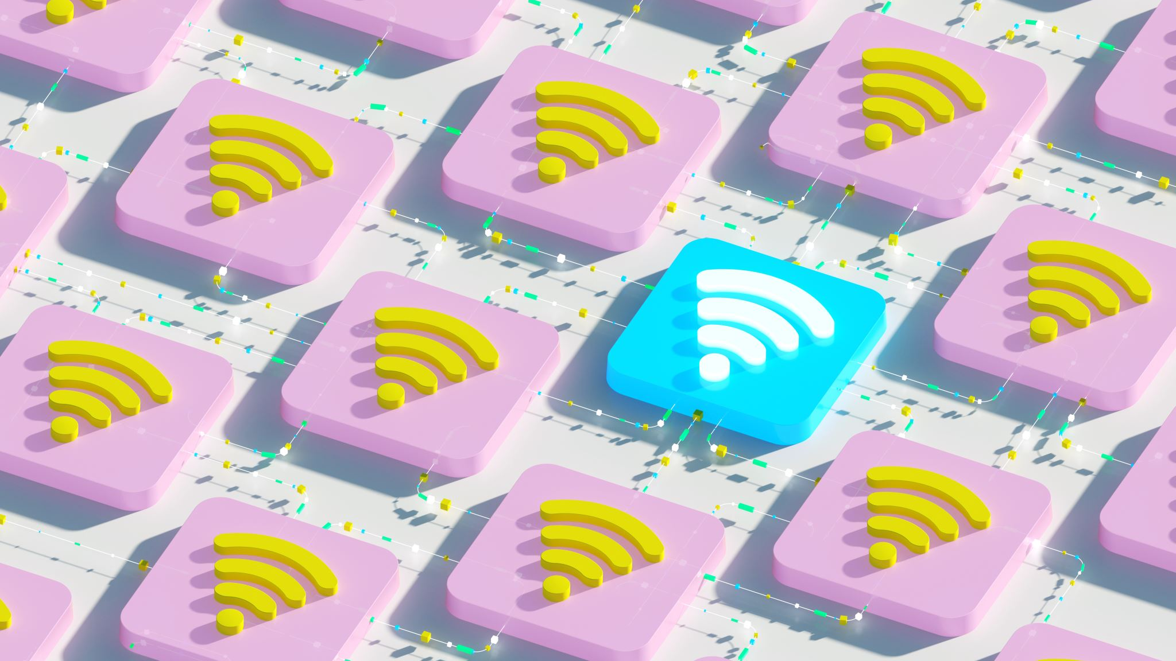
Internet Protocol

Slide 31
Transmission Control Protocol (TCP)/ Internet Protocol (IP)
It is a set of standardized rules that uses a client-server model of communication in which a user or machine (a client) requests a service by a server in the network.
The IP protocol ensures that each computer or node connected to the Internet is assigned an IP address, which is used to identify each node independently.(IP Address is like Aadhar Card for any node)
TCP ensures that the message or data is broken into smaller chunks, called IP packets.
Each of these packets are routed (transmitted) through the Internet, along a path from one router to the next, until it reaches the specified destination

Slide 32
TCP guarantees the delivery of packets on the designated IP address. It is also responsible for ordering the packets so that they are delivered in sequence.
#1. There are many connection path in Internet so, there are many possible paths between two hosts. Hence, two packets of the same message can take two different routes depending on congestion and other factors in different possible routes.
#2.When all the packets finally reach the destination machine, they are reassembled into the original message at the receiver’s end.

Slide 33

Questions
what is a protocol in communications?
why do we need protocols?
full form of
1)HTTP 2)FTP 3)PPP 4)SMPT 5)TCP 6)IP

Slide 34
Questions
what is TCP?[S31]
what is IP protocol used for ?[S31]
what are IP packets[S31]

Slide 35

Questions (MCQ)
Q A computer network:
Is a collection of hardware components and computers
Is interconnected by communication channel
Allows sharing of resources and information
All of the above

Slide 36
Questions
Q What is a Firewall in computer network?:
A system designed to prevent unauthorized access
A web browsing software
The physical boundary of network
An operating system of computer network

Slide 37
Questions
Q What is the use of Bridge in the Network?
To connect LANs
To separate LANs
To control network speed
All of the above

Slide 38
Questions
Q Which of the following is the smallest network?
WAN
MAN
PAN
LAN

Slide 39
Questions
Q Which of these is not a communication channel?
Satellite
Microwave
Radio wave
Wi-Fi

Slide 40
Questions
Q Which of the following is the fastest media of data transfer?
Co-axial Cable
Untwisted Wire
Telephone Lines
Fiber Optic

Slide 41
Questions
Q The location of a resource on the internet is given by its?
Protocol
URL
E-mail address
ICQ

Slide 42
Questions
Q the term HTTP stands for?
Hyper terminal tracing program
Hypertext tracing protocol
Hypertext transfer protocol
Hypertext transfer program

Slide 43
Questions
Q Which one of the following is the most common internet protocol?
HTML
NetBEUI
TCP/IP
IPX/SPX

Slide 44
Questions
Q The term FTP stands for?
File transfer program
File transmission protocol
File transfer protocol
File transfer protection

Slide 45
Questions
Q Which of the following is not an unit for data transfer rate?
MBPS
KBPS
SBPS
GBPS

Slide 46
Questions
Q Bluetooth is an example of:
Wide area network
Virtual private network
Local area network
Personal area network

Slide 47
Questions
Q A device which can be connected to a network without using cable is called:
Distributed device
Centralized device
Open-source device
Wireless device

Slide 48
Questions
Q Which of the following appears harmless but actually performs malicious functions such as deleting or damaging files.
WORM
Virus
Trojan Horse
Malware

Slide 49
Questions
Q Name the protocol that is used to send emails:
FTP
SMTP
HTTP
TCP

Slide 51

THANK YOU
Made by :
Sannidhya Sahoo
Mohd Sahil
Sachin Duhan
Vibhas Reddy
Bhargav Dinesh

